Slide 1
Laplacian kernel splatting for efficient Depth-of-field and motion blur synthesis or reconstruction
Thomas Leimkühler, MPI Informatik
Hans-Peter Seidel, MPI Informatik
Tobias Ritschel, UCL

Slide 2
Photography &
Recording Encouraged

Slide 3
Laplacian kernel splatting for efficient depth-of-field and motion blur synthesis or reconstruction
Thomas Leimkühler, Hans-Peter Seidel, Tobias Ritschel

Slide 4
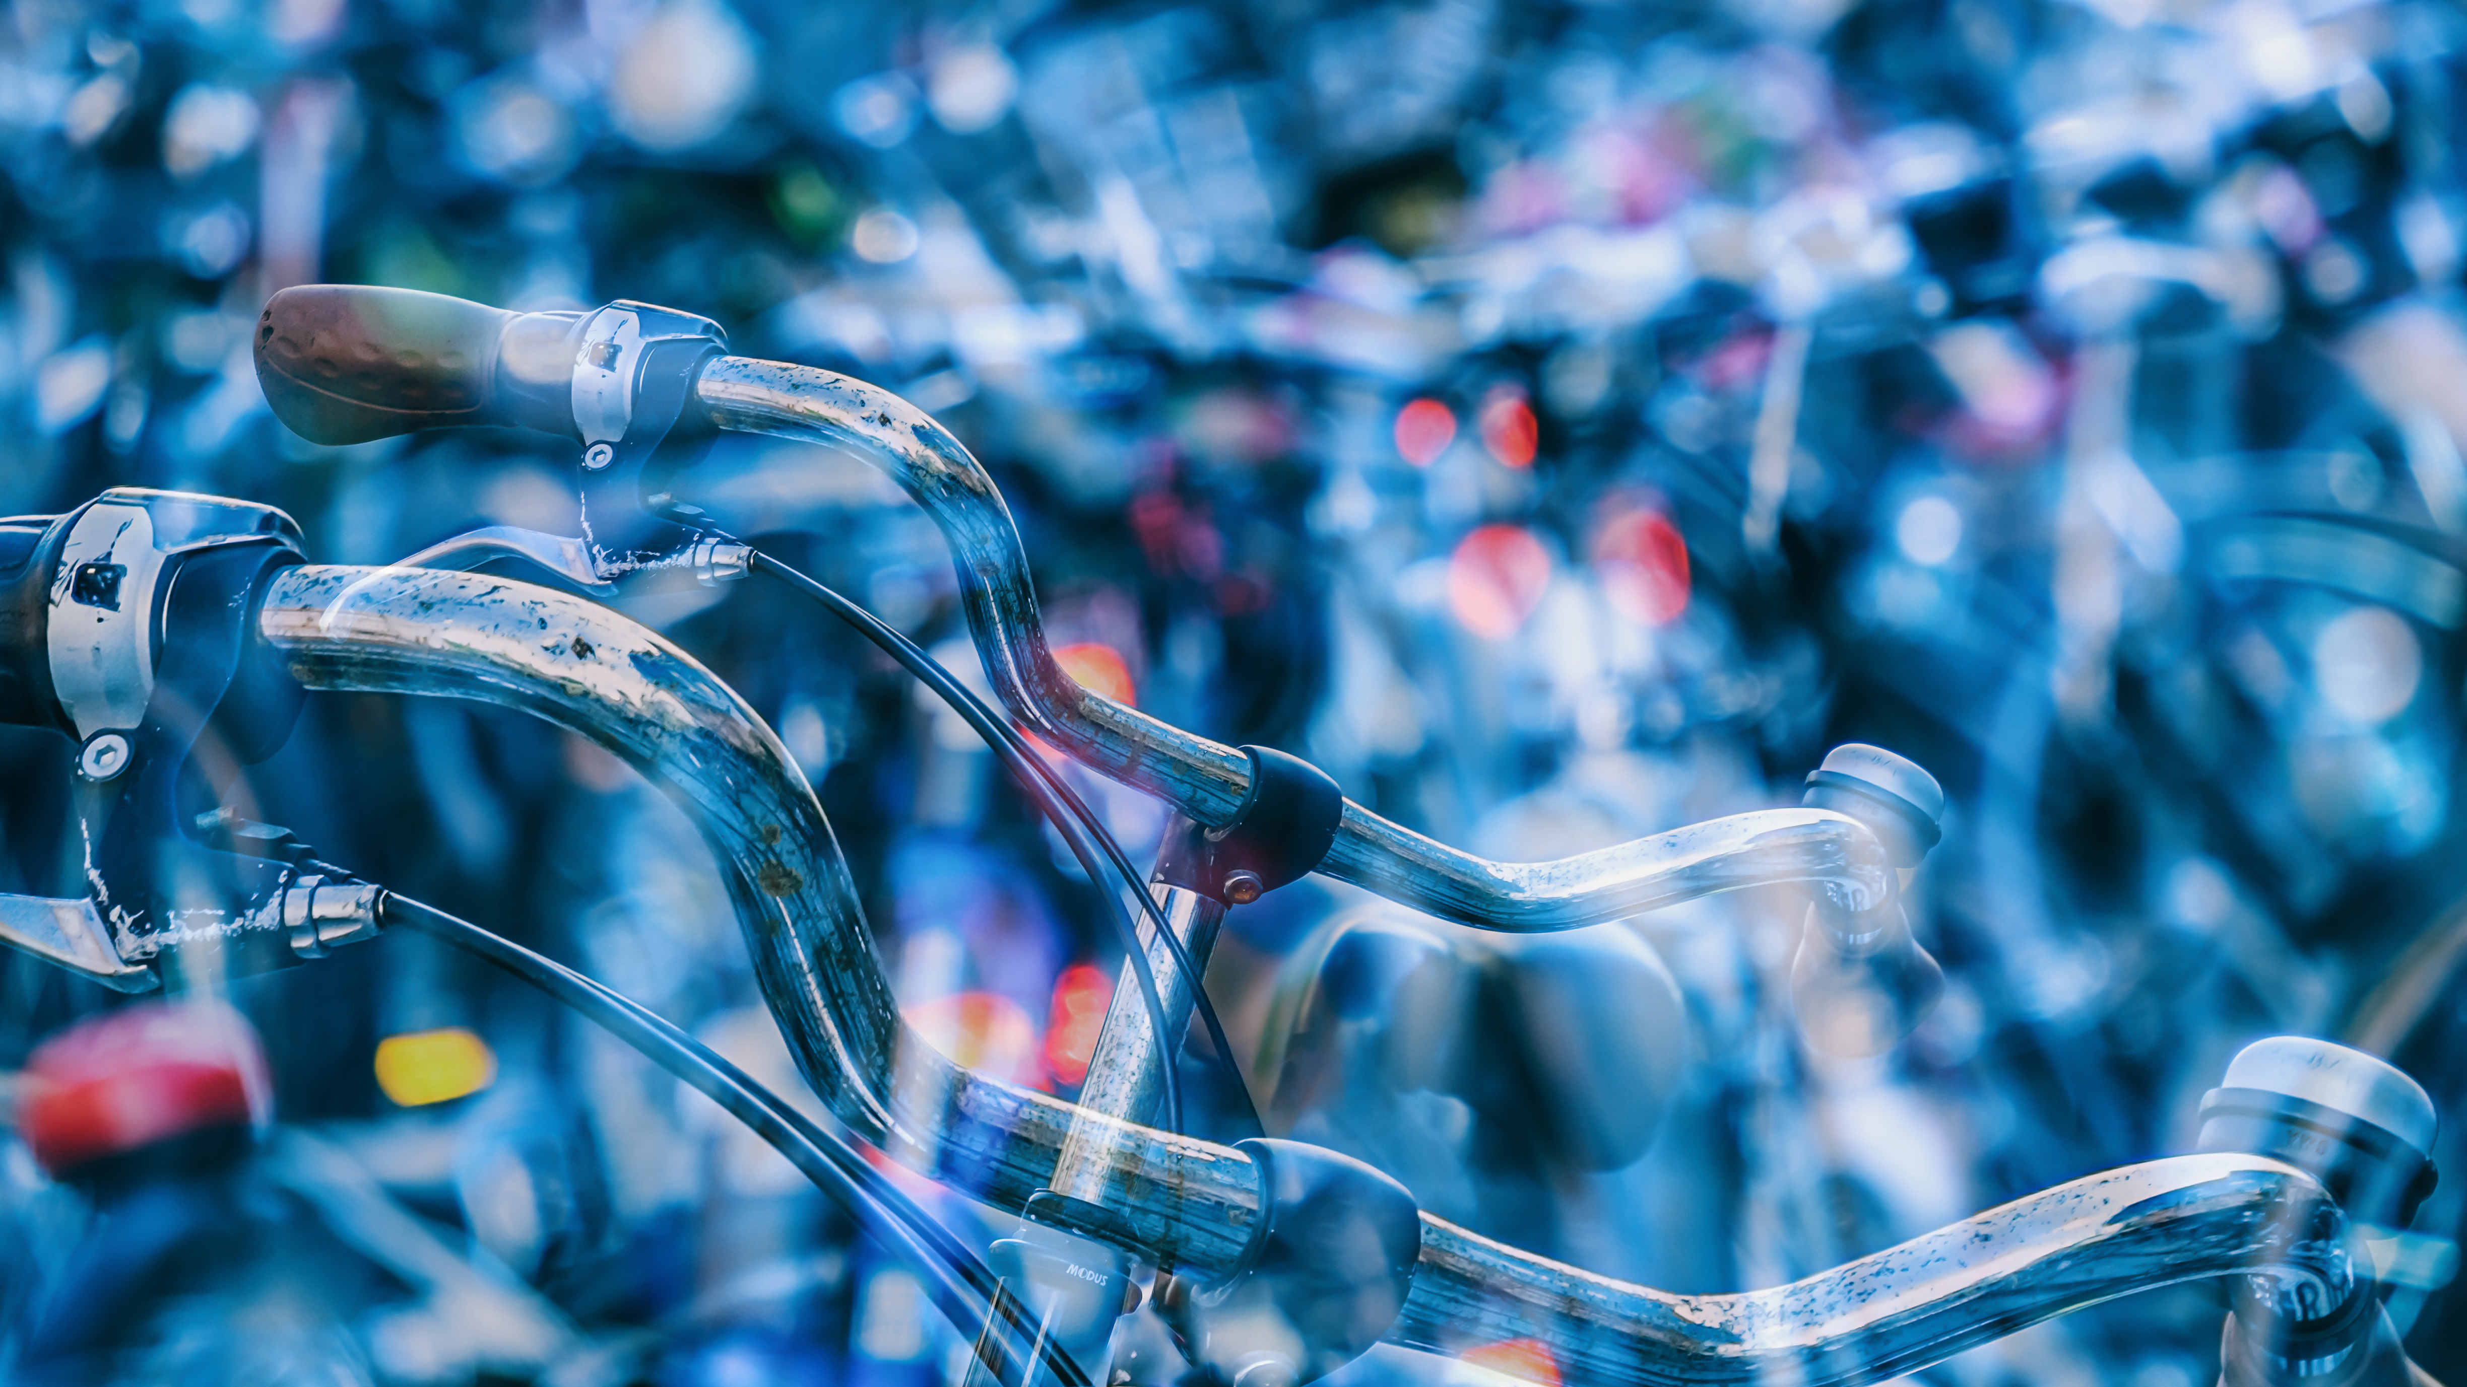
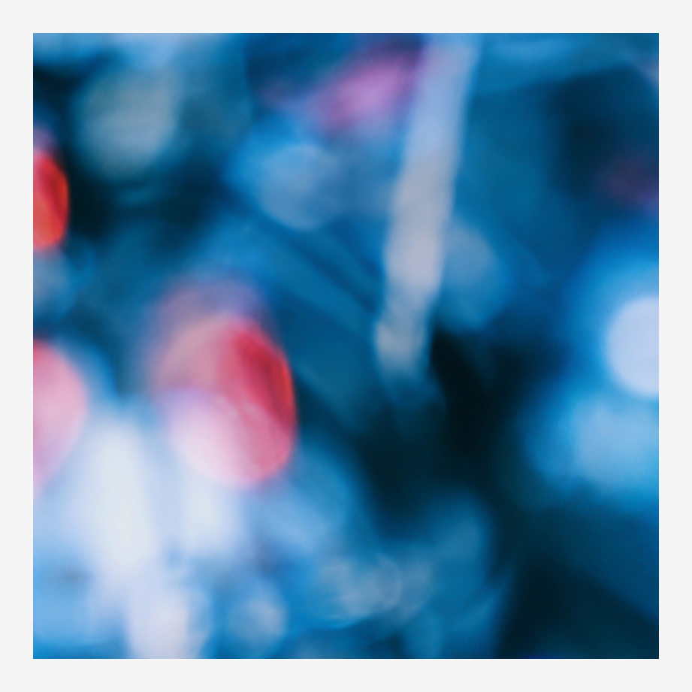

Slide 5
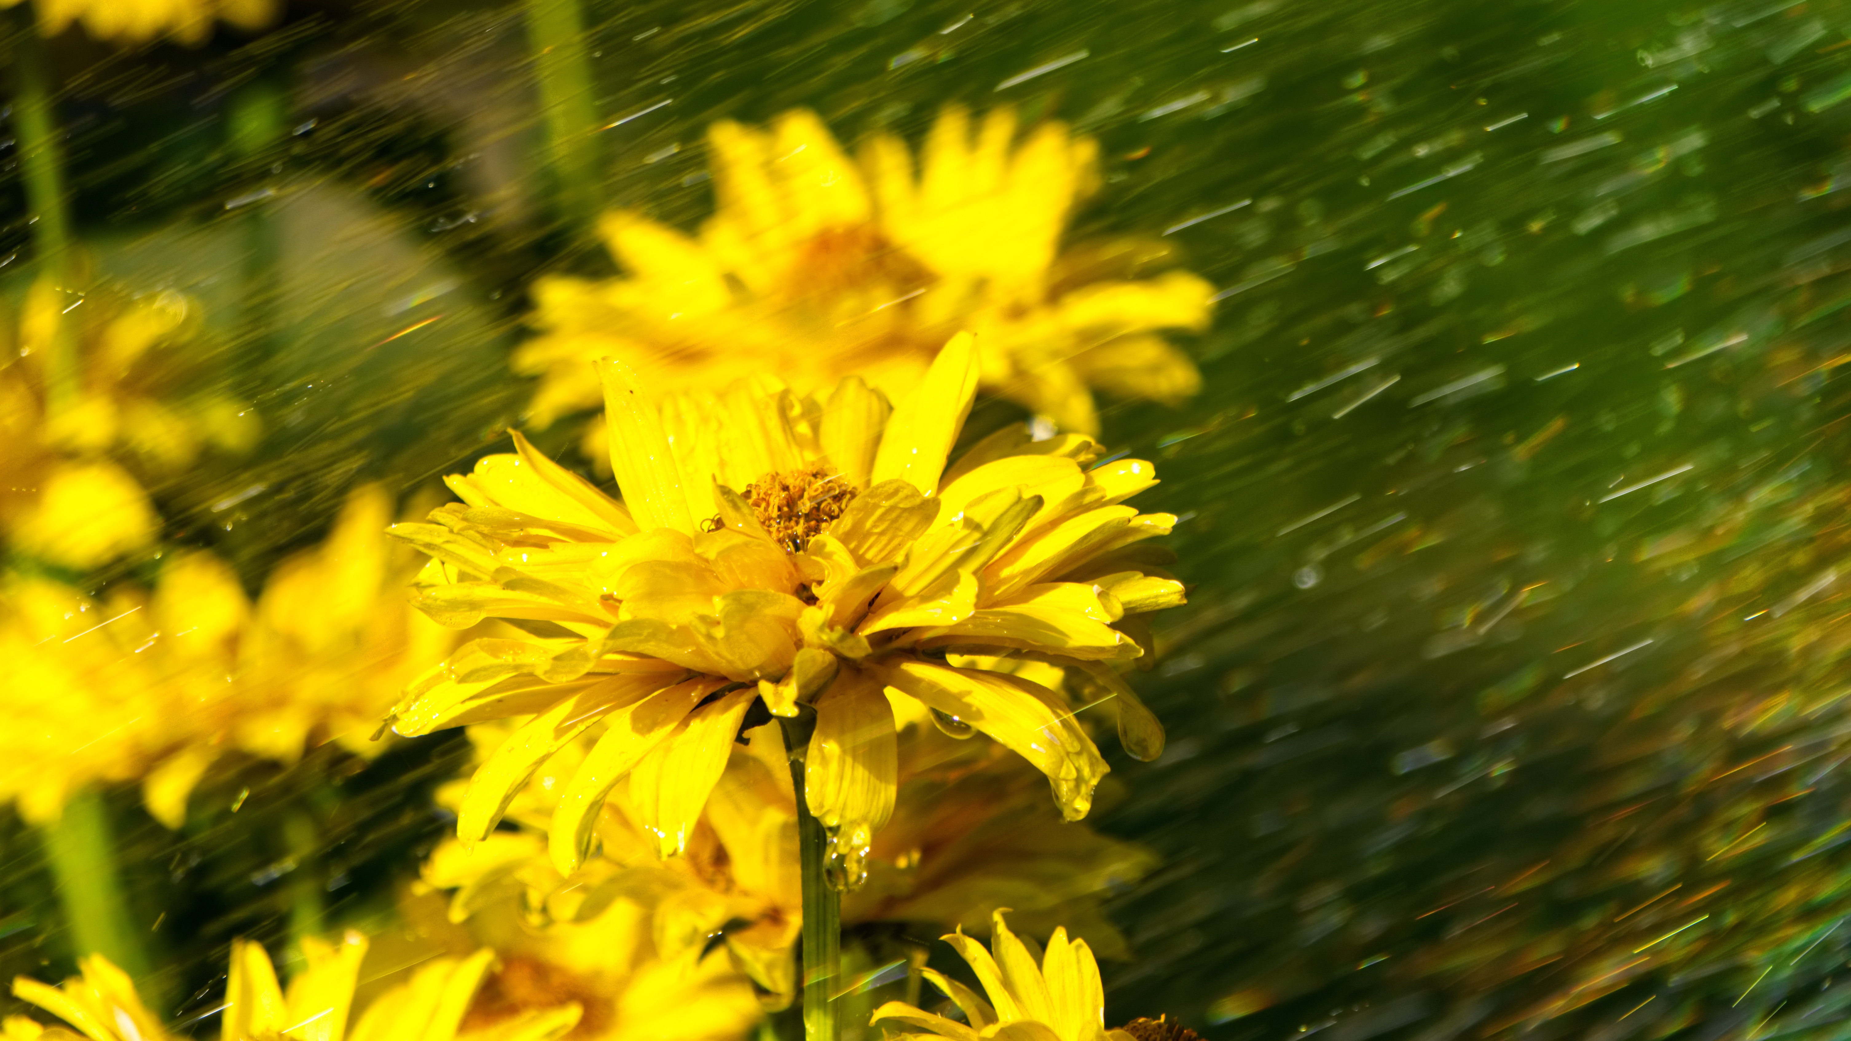
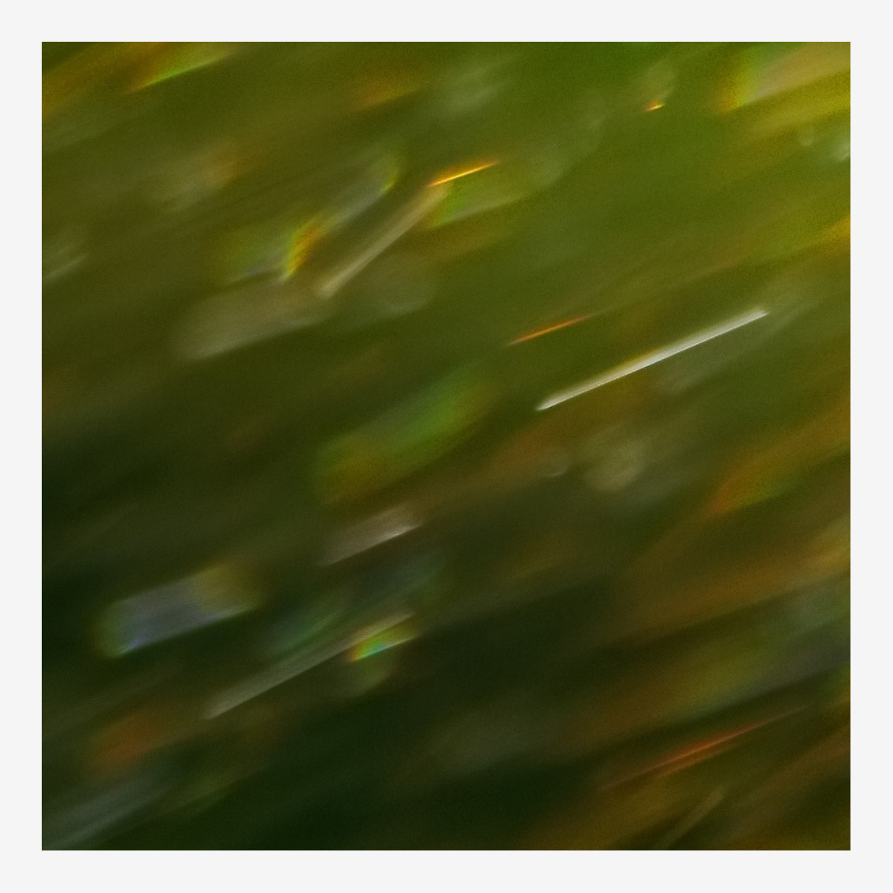

Slide 6
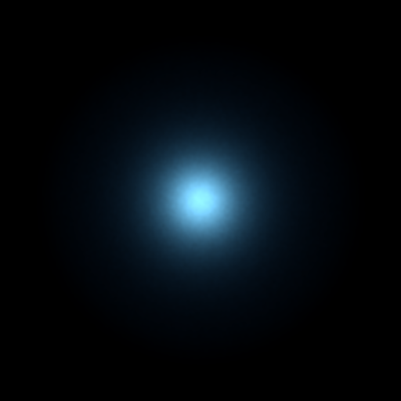
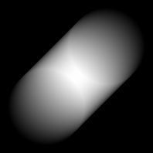
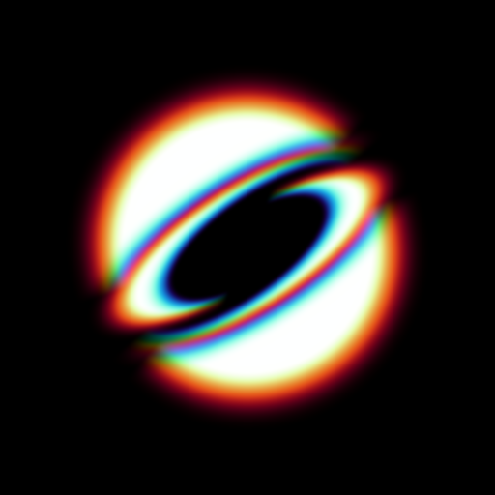
Goals
General point spread functions
Arbitrary combinations of different effects
Physical models
Interactive performance
Thomas Leimkühler: Laplacian Kernel Splatting for Efficient Depth-of-Field and Motion Blur Synthesis or Reconstruction

Slide 7
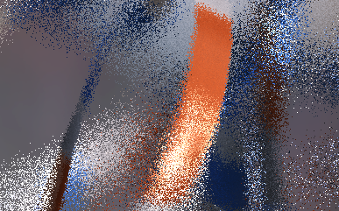
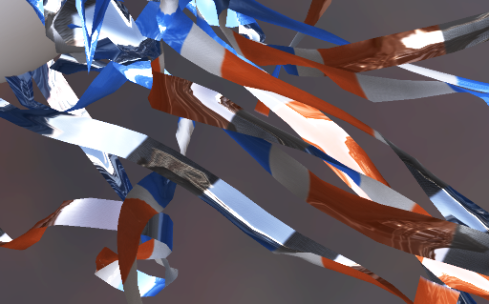
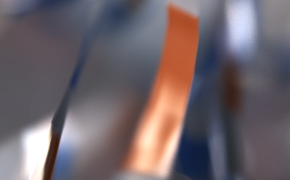
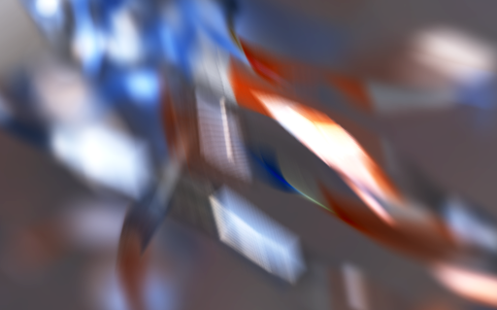
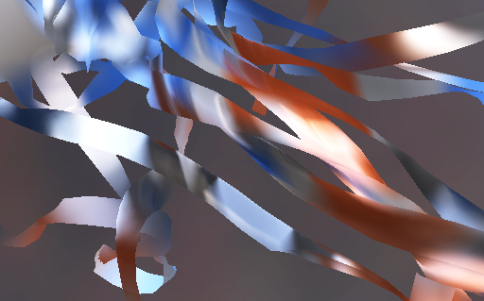
Distribution effects in Computer graphics
Stochastic
Pinhole
Convergence
Reconstruction
Splatting
Filtering
Slow
Fast
Thomas Leimkühler: Laplacian Kernel Splatting for Efficient Depth-of-Field and Motion Blur Synthesis or Reconstruction

Slide 8
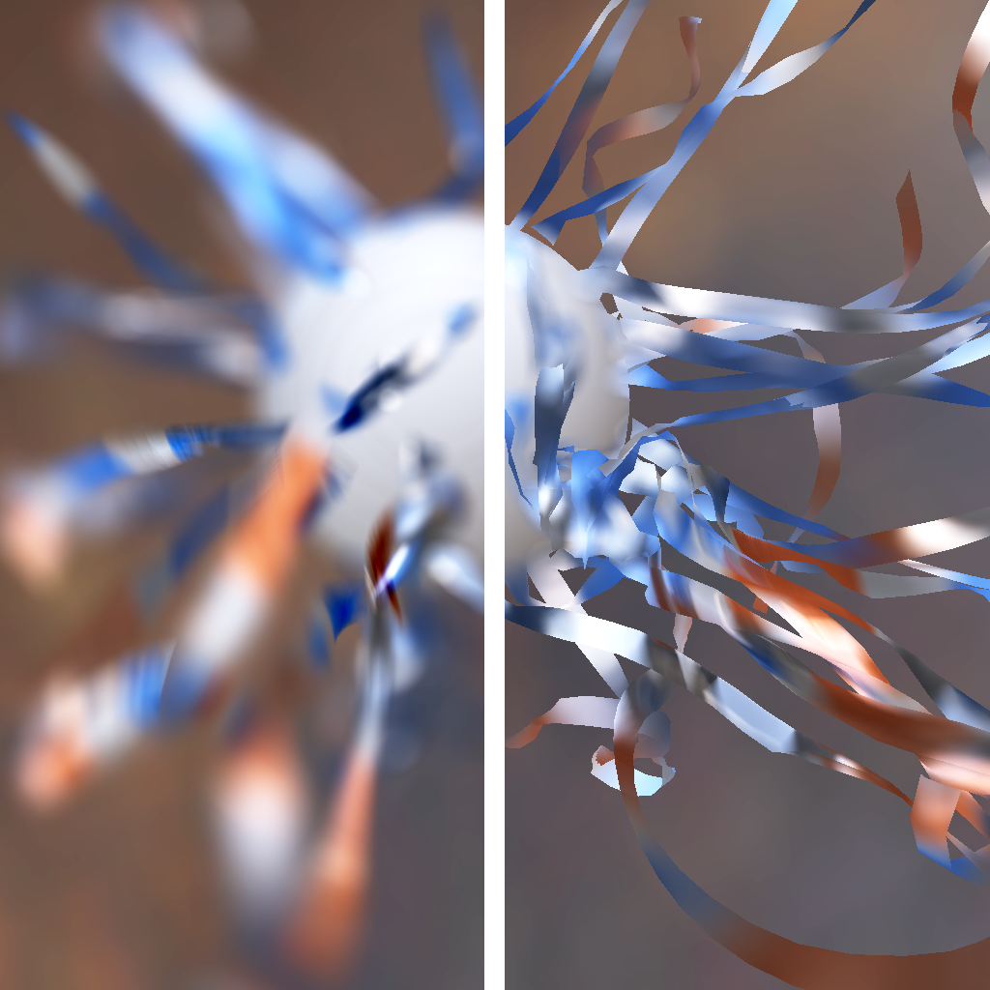
Splatting vs. Filtering
Splatting
Filtering
Quality:
Quality:
Accurate and versatile
Crude approximation, Problems at silhouettes
Speed:
Speed:
Scattering
Gathering
Thomas Leimkühler: Laplacian Kernel Splatting for Efficient Depth-of-Field and Motion Blur Synthesis or Reconstruction

Slide 9
Distribution effects in Computer graphics
Stochastic
Pinhole
Convergence
Reconstruction
Splatting
Filtering
Slow
Fast
Thomas Leimkühler: Laplacian Kernel Splatting for Efficient Depth-of-Field and Motion Blur Synthesis or Reconstruction

Slide 10
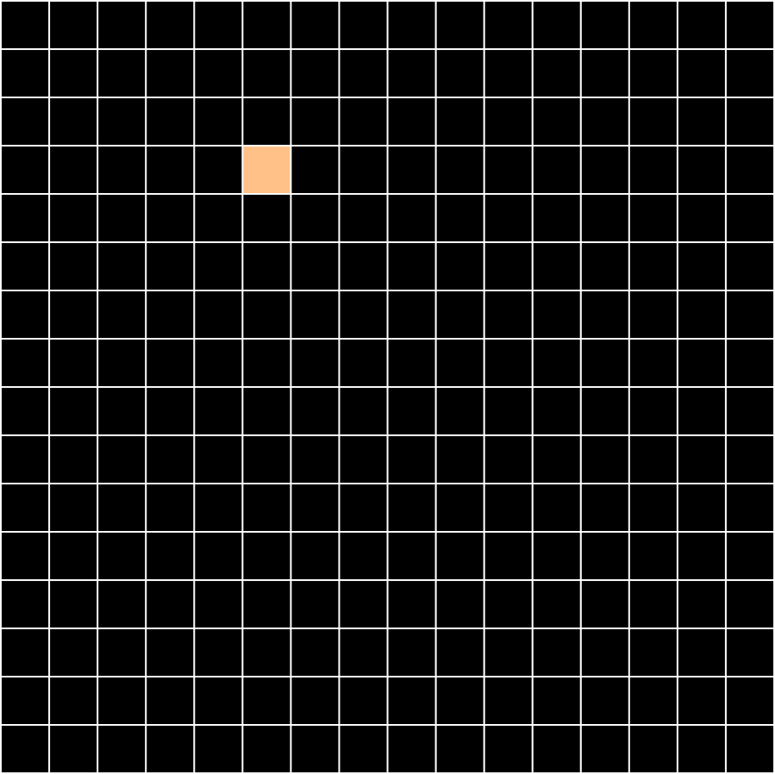
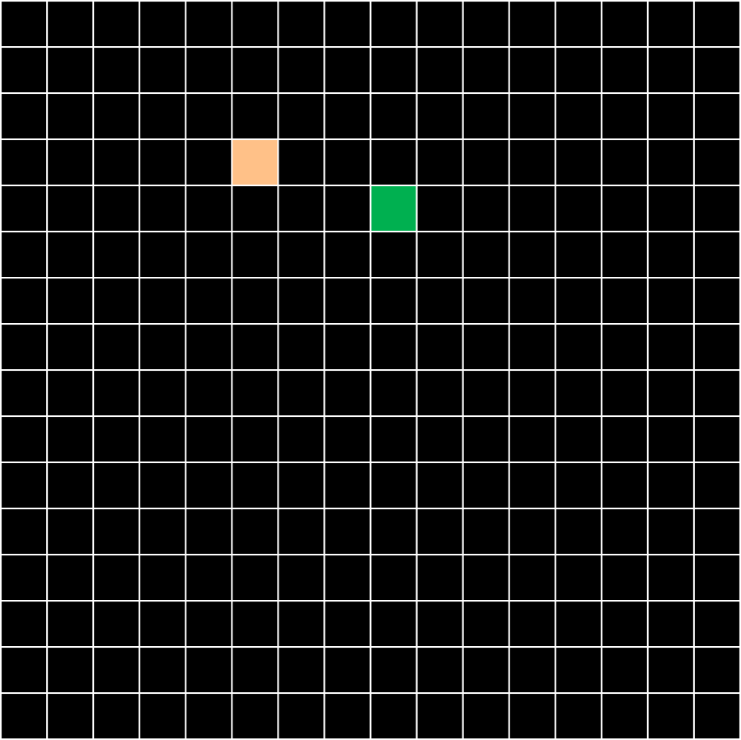
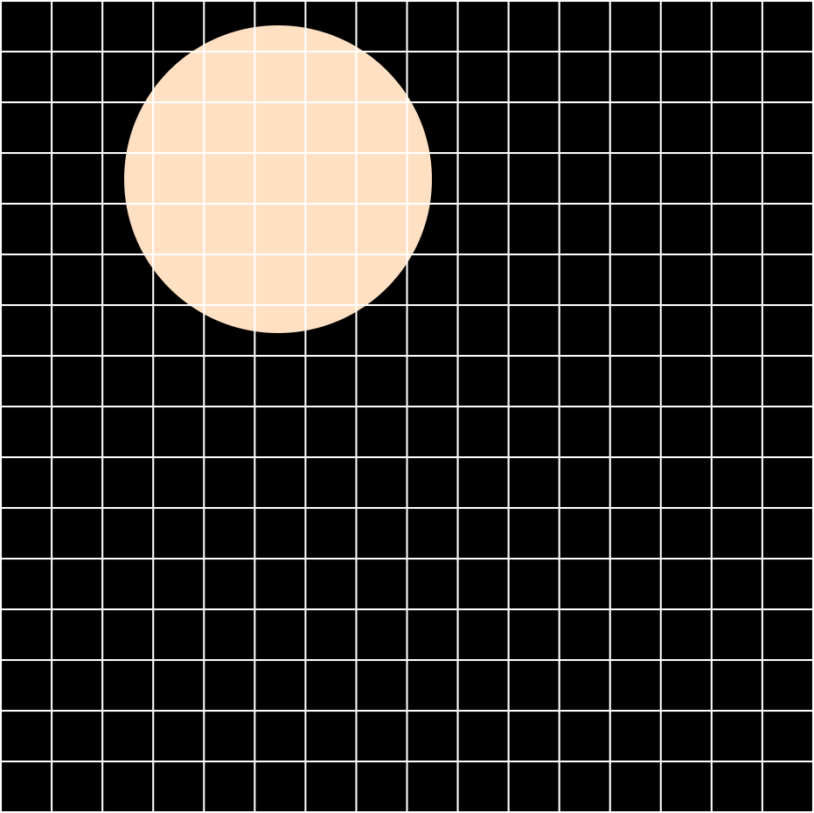
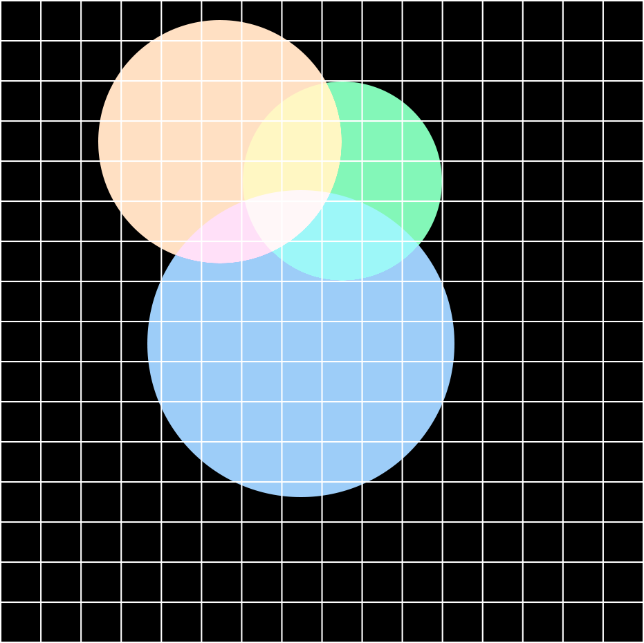
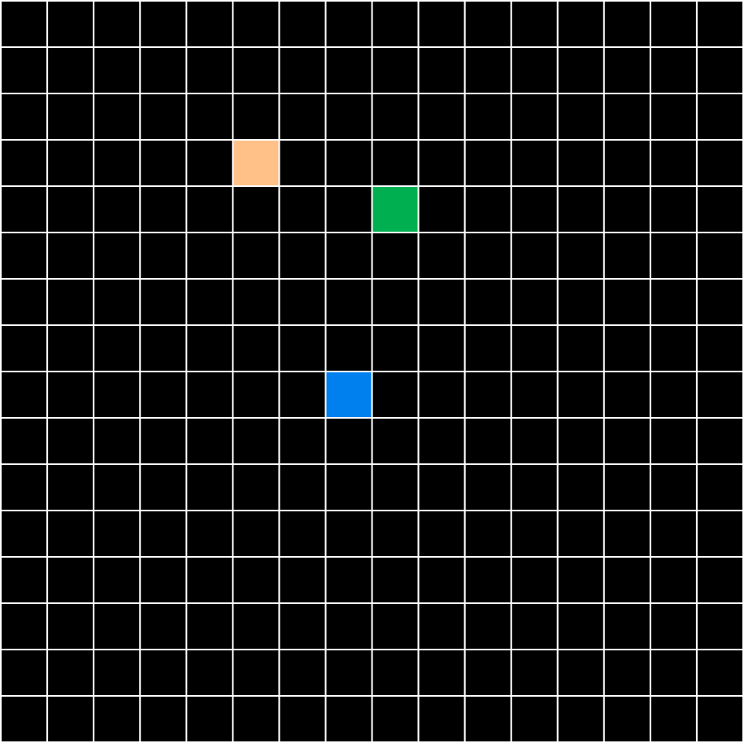
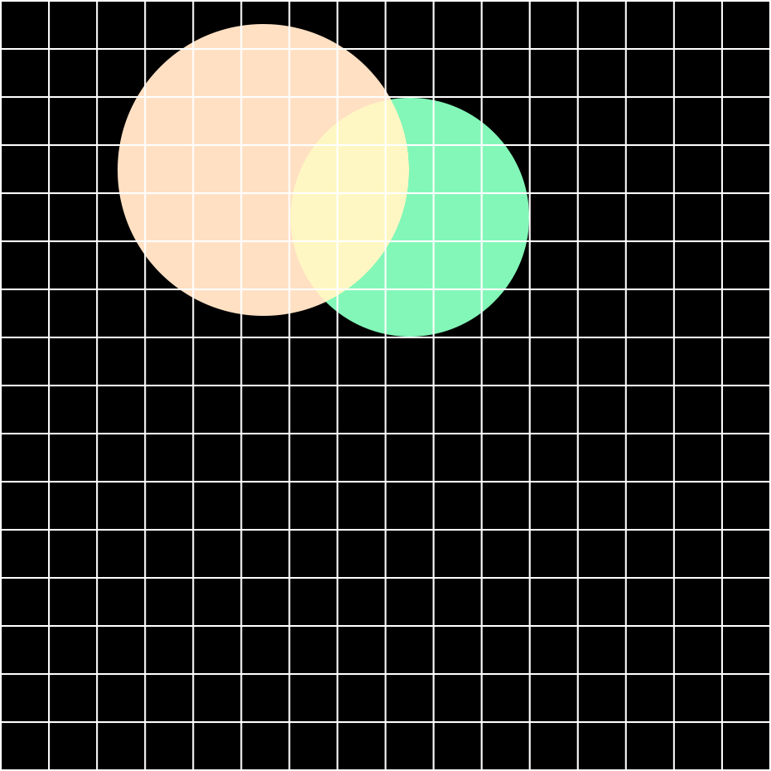
Kernel splatting
Pinhole Input
Splatting Output
Kernel of each input pixel can affect a large image area!
Thomas Leimkühler: Laplacian Kernel Splatting for Efficient Depth-of-Field and Motion Blur Synthesis or Reconstruction

Slide 11
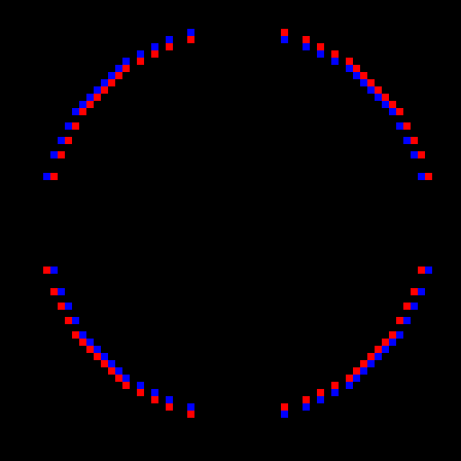
Differential Kernel
Differentiate
Integrate
Dense
Sparse
Thomas Leimkühler: Laplacian Kernel Splatting for Efficient Depth-of-Field and Motion Blur Synthesis or Reconstruction

Slide 12
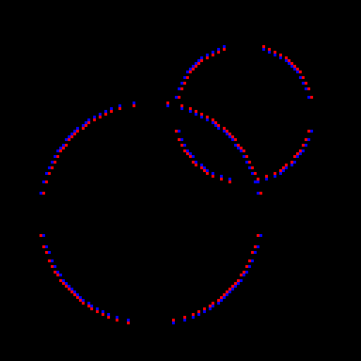
Differential rasterization
Basic Procedure:
Additive Splatting
Image
Splat sparse differential kernels
$$splat\left(f, I\right) = \int{splat\left(\frac{df}{dx}, I\right)dx}$$
Spatially-varying
Kernel
Integrate image
Thomas Leimkühler: Laplacian Kernel Splatting for Efficient Depth-of-Field and Motion Blur Synthesis or Reconstruction

Slide 13
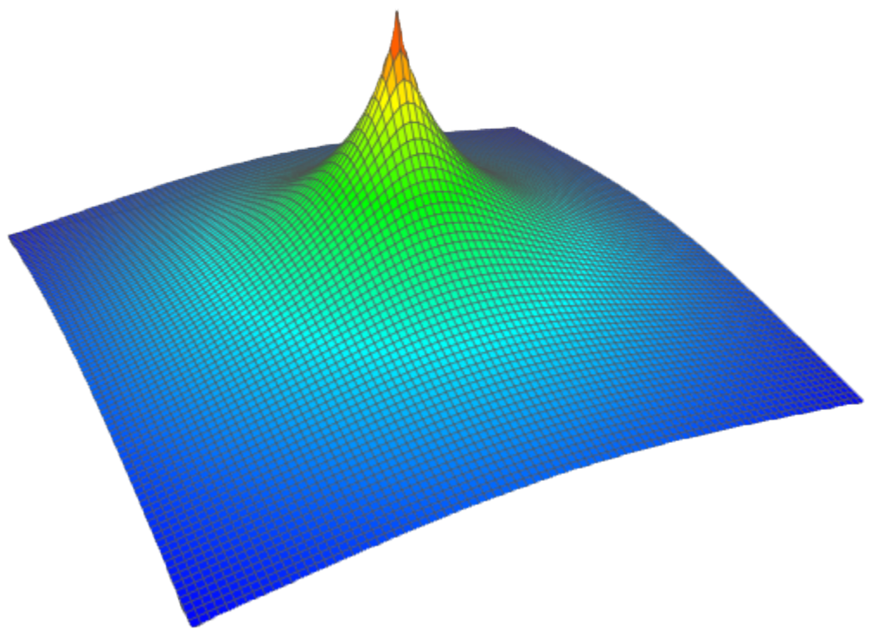
Which Differential?
$$∆f\left(x,y\right)=\frac{∂^{2}f}{∂x^{2}}+\frac{∂^{2}f}{∂y^{2}}$$
Differential operator of choice: Laplacian
Why?!
Scalar Value | Efficient Integration | Rotational Invariance
Splat into regular RGBA textures
Poisson problem, Green’s function
Convolution pyramids*
Many point spread functions have this property
Save an entire sampling dimension
$$\left({\frac{∂f}{∂x} \atop \frac{∂f}{∂y}}\right)$$
$$\frac{∂^{2}f}{∂x^{2}}+\frac{∂^{2}f}{∂y^{2}}$$
$$∆$$
$$f$$
$$=$$
$$∆f$$
Laplacian: 1D
Gradient: 2D
* Farbman et al., ACM Trans. Graph. 30, 6, 2011
Thomas Leimkühler: Laplacian Kernel Splatting for Efficient Depth-of-Field and Motion Blur Synthesis or Reconstruction

Slide 14
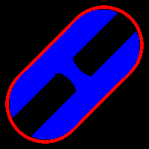
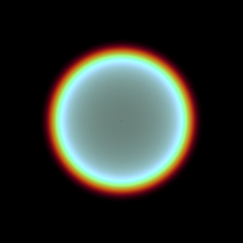
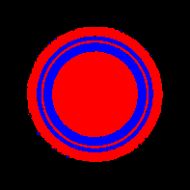
most Kernels have dense laplacians
Significant
Laplacian Pixels
Kernel
$$∆$$
Motion Blur +
Depth-of-Field
Our solution:
Precompute a sparse approximation of the Laplacian
$$∆$$
Physical
Depth-of-Field
Thomas Leimkühler: Laplacian Kernel Splatting for Efficient Depth-of-Field and Motion Blur Synthesis or Reconstruction

Slide 15
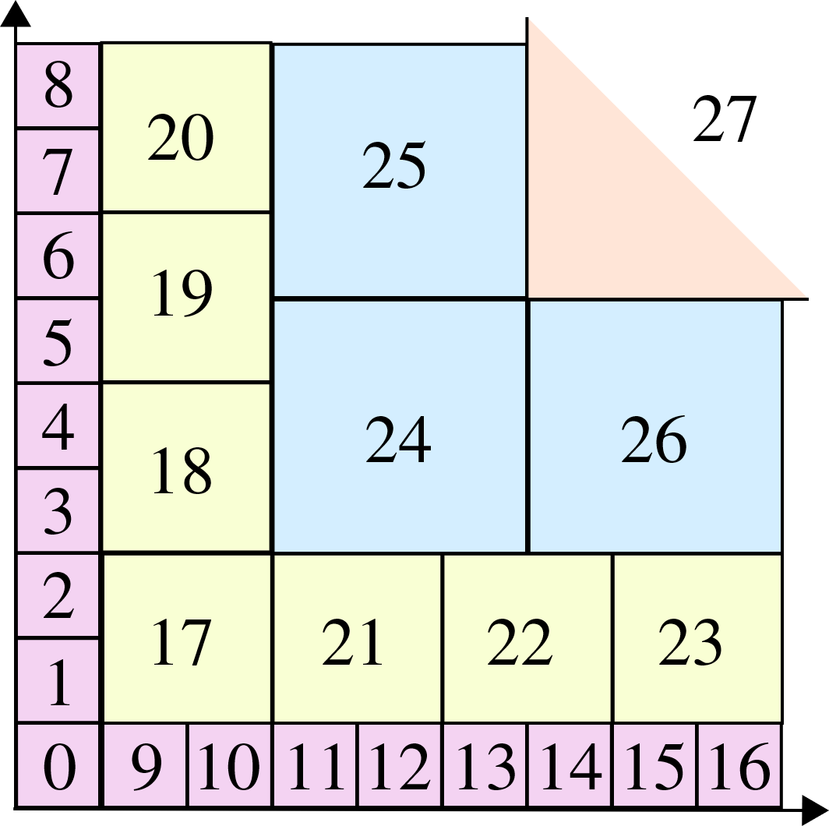
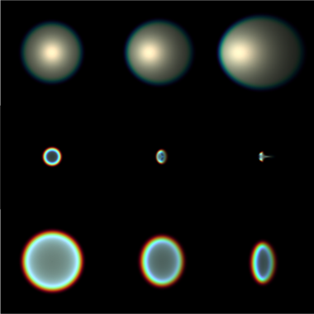
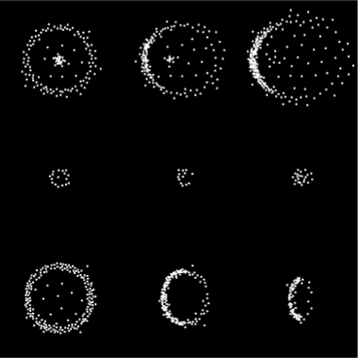
Pre-computation Overview
1. Parametrization &
Sampling
2. Kernel Generation
3. Sparsification
Thomas Leimkühler: Laplacian Kernel Splatting for Efficient Depth-of-Field and Motion Blur Synthesis or Reconstruction

Slide 16
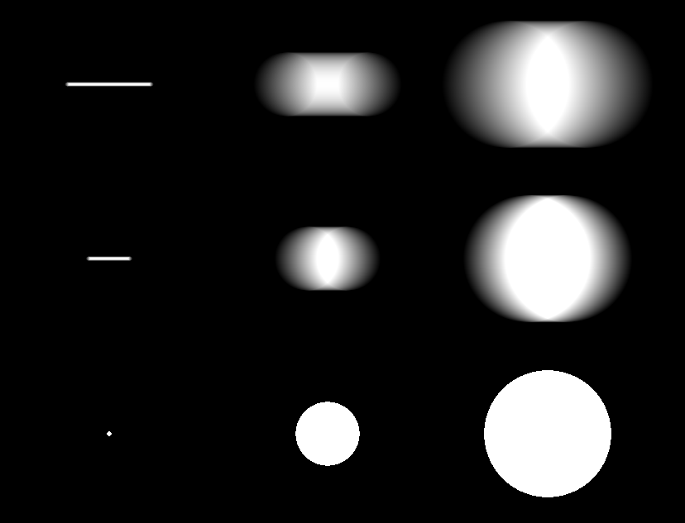
Parametrization
Speed
Angular sampling not required!
Circle of Confusion
Thomas Leimkühler: Laplacian Kernel Splatting for Efficient Depth-of-Field and Motion Blur Synthesis or Reconstruction

Slide 17
Sampling in kernel space
Speed
High
Low
Sample Density
Circle of Confusion
Thomas Leimkühler: Laplacian Kernel Splatting for Efficient Depth-of-Field and Motion Blur Synthesis or Reconstruction

Slide 18
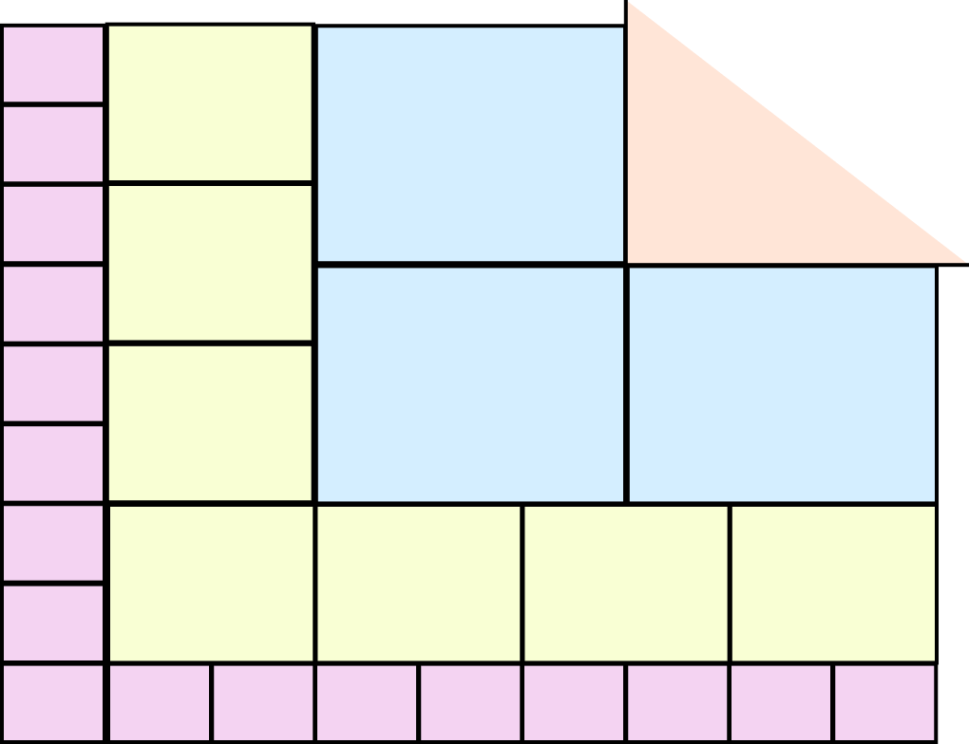
Sampling in kernel space
Speed
Circle of Confusion
Thomas Leimkühler: Laplacian Kernel Splatting for Efficient Depth-of-Field and Motion Blur Synthesis or Reconstruction

Slide 19
Sampling in kernel space
Speed
Non-uniform sampling
Constant access time
Storage reduction: Exponential → Polynomial
Circle of Confusion
Thomas Leimkühler: Laplacian Kernel Splatting for Efficient Depth-of-Field and Motion Blur Synthesis or Reconstruction

Slide 20
Pre-computation Overview
1. Parametrization &
Sampling
2. Kernel Generation
3. Sparsification
Thomas Leimkühler: Laplacian Kernel Splatting for Efficient Depth-of-Field and Motion Blur Synthesis or Reconstruction

Slide 21
Kernel generation
Select kernel parameters
Depth
Eccentricity
Motion
Sample integrand: Light tracing
Time
Lens
Sensor
Lens
World Point
Thomas Leimkühler: Laplacian Kernel Splatting for Efficient Depth-of-Field and Motion Blur Synthesis or Reconstruction

Slide 22
Pre-computation Overview
1. Parametrization &
Sampling
2. Kernel Generation
3. Sparsification
Thomas Leimkühler: Laplacian Kernel Splatting for Efficient Depth-of-Field and Motion Blur Synthesis or Reconstruction

Slide 23
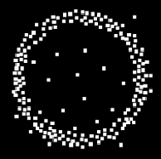
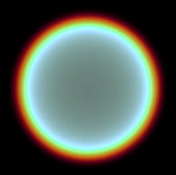
sparsification
Objective: Find a sparse set of points that yields the desired kernel after integration
$$\min{\int_{Ω}{\left\|f\left(x\right)−\int_{Ω}{\sum_{i=0}^{n}{splat(p_{i}, {Δ\overline{f}}_{i})ⅆx}}\right\|ⅆx}}$$
Kernel
Reconstruction
$n$ : Number of Points
$p$ : Point Positions
$Δ\overline{f}$ : Point Values
Thomas Leimkühler: Laplacian Kernel Splatting for Efficient Depth-of-Field and Motion Blur Synthesis or Reconstruction

Slide 24
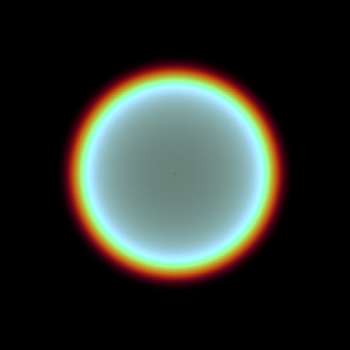
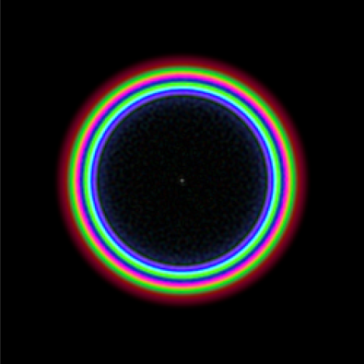
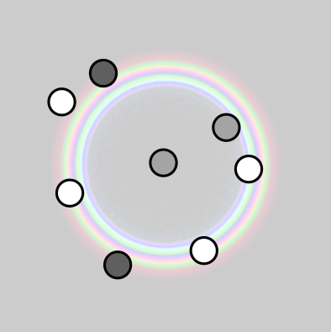
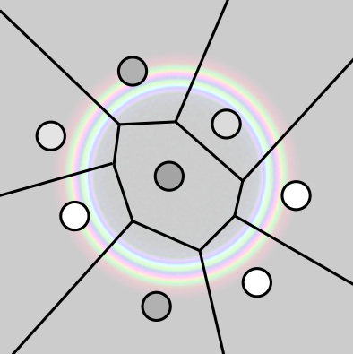
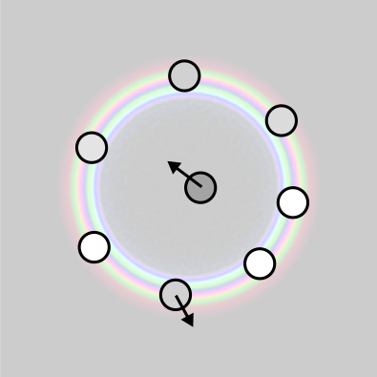
sparsification
Determines
Number of Points
Determines
Point Positions and Values
Laplacian
Image Filter
Dart
Throwing
Lloyd
Relaxation
Simulated
Annealing
Kernel
Thomas Leimkühler: Laplacian Kernel Splatting for Efficient Depth-of-Field and Motion Blur Synthesis or Reconstruction

Slide 25
Pre-computation Overview
1. Parametrization &
Sampling
2. Kernel Generation
3. Sparsification
Thomas Leimkühler: Laplacian Kernel Splatting for Efficient Depth-of-Field and Motion Blur Synthesis or Reconstruction

Slide 26
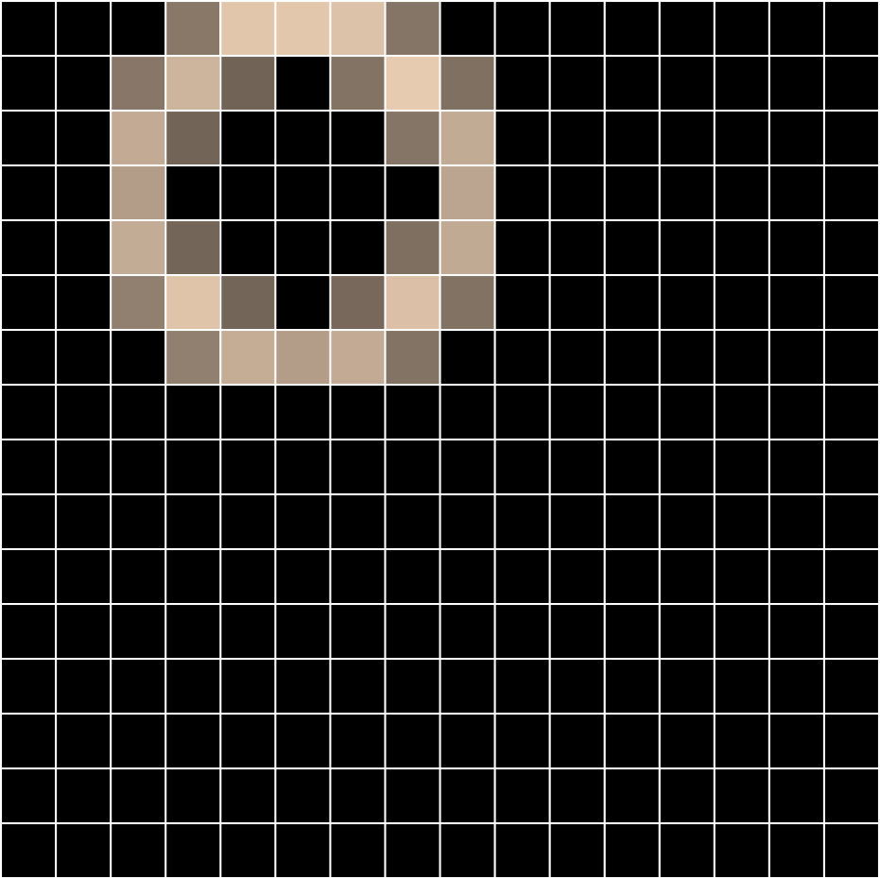
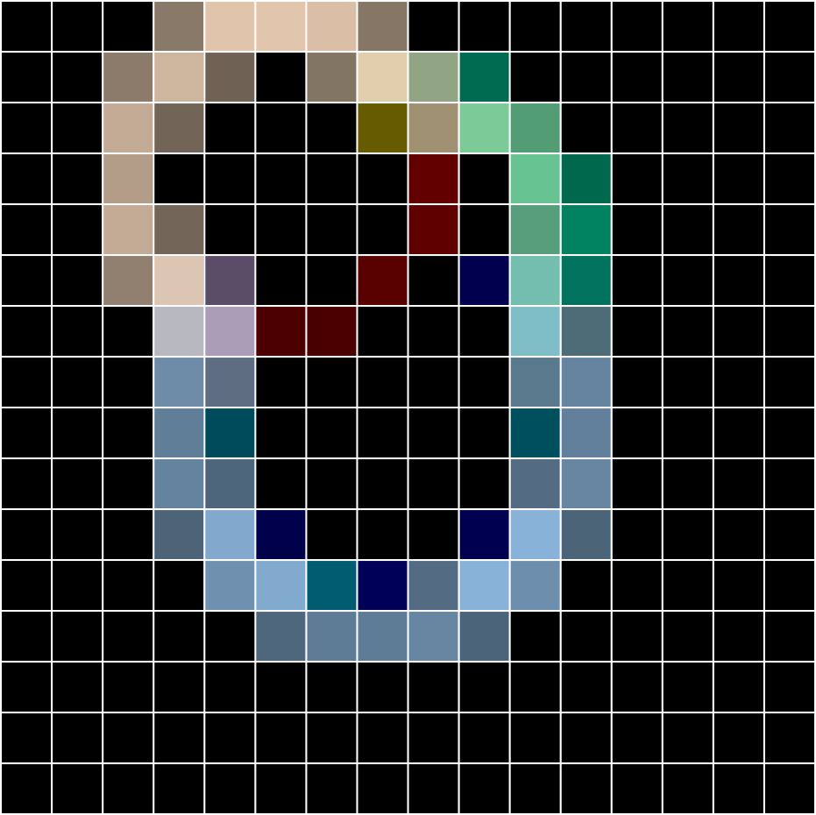
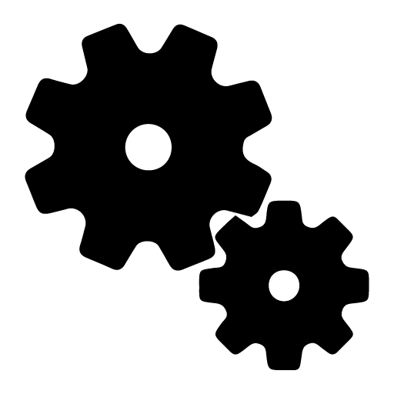
Pipeline
Point Buffer (Positions & Values)
Pre-Computation
Runtime
Thomas Leimkühler: Laplacian Kernel Splatting for Efficient Depth-of-Field and Motion Blur Synthesis or Reconstruction

Slide 28
Distribution effects in Computer graphics
Stochastic
Pinhole
Convergence
Reconstruction
Splatting
Filtering
Slow
Fast
Thomas Leimkühler: Laplacian Kernel Splatting for Efficient Depth-of-Field and Motion Blur Synthesis or Reconstruction

Slide 29
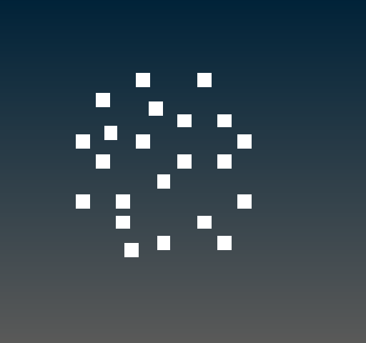
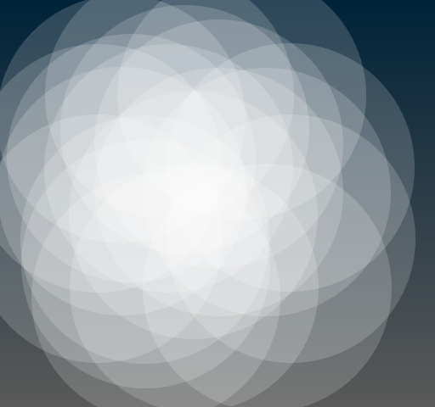
reconstruction
Thomas Leimkühler: Laplacian Kernel Splatting for Efficient Depth-of-Field and Motion Blur Synthesis or Reconstruction

Slide 30
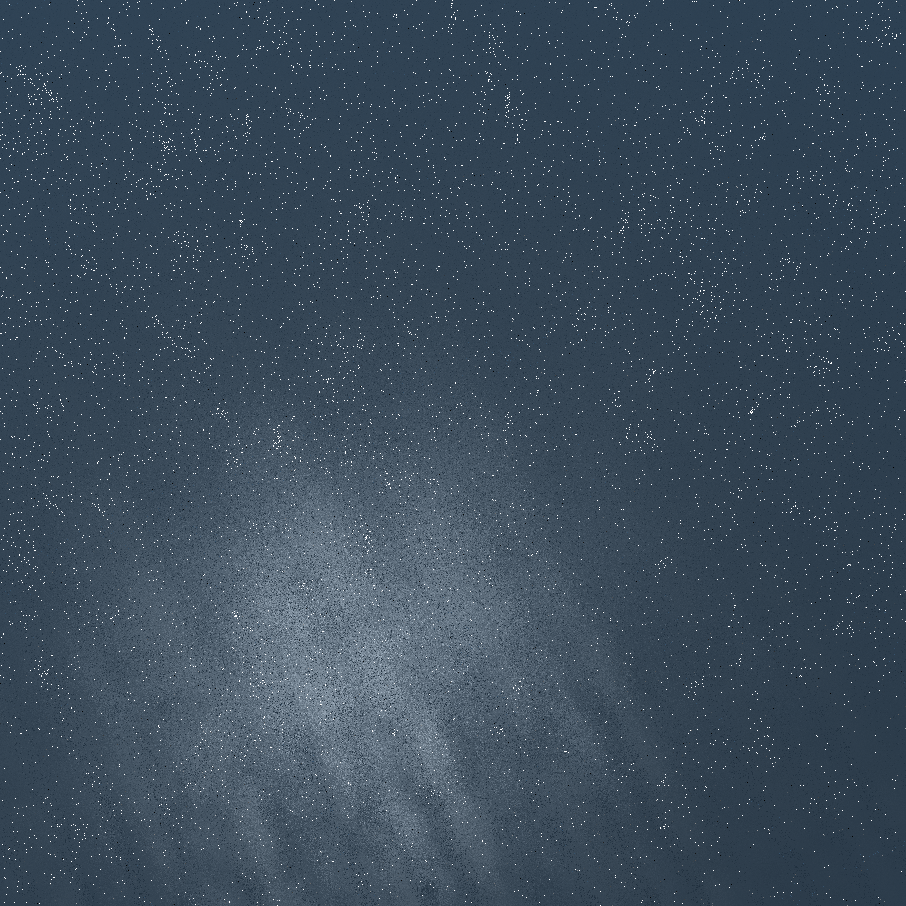
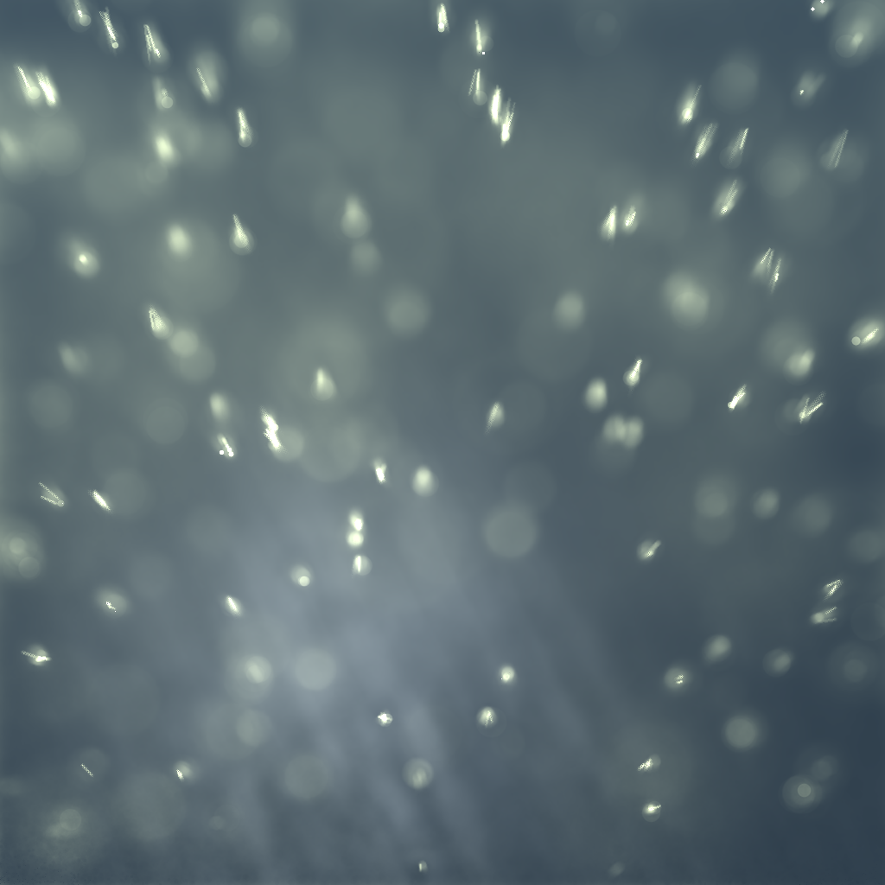
Results: reconstruction
1 spp
500 ms, SSIM .95
Reference
on GTX 980 Ti
Thomas Leimkühler: Laplacian Kernel Splatting for Efficient Depth-of-Field and Motion Blur Synthesis or Reconstruction

Slide 31
Conclusion
Kernel splatting for high-quality distribution effects
Interactive rates by splatting sparse differentials
Pre-computation required
Synthesis and reconstruction
Thomas Leimkühler: Laplacian Kernel Splatting for Efficient Depth-of-Field and Motion Blur Synthesis or Reconstruction

Slide 32
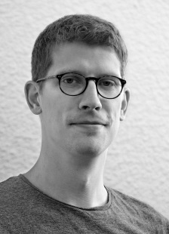
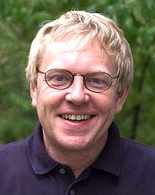
Thank you!
Project Webpage
laplaciansplatting.mpi-inf.mpg.de
Contact tleimkueh@mpi-inf.mpg.de
T. Leimkühler
H.-P. Seidel
T. Ritschel
Thomas Leimkühler: Laplacian Kernel Splatting for Efficient Depth-of-Field and Motion Blur Synthesis or Reconstruction

Slide 33
Numbers
Model | Sample Count | Size | Sparsity
DoF | 100 | 1.1 MB | 31 %
DoF+MB | 400 | 4.2 MB | 9 %
Physical Lens | 4000 | 30.8 MB | 2 %
Volume | 200 | 5.3 MB | 18 %
Stylized | 200 | 9.0 MB | 25 %
Thomas Leimkühler: Laplacian Kernel Splatting for Efficient Depth-of-Field and Motion Blur Synthesis or Reconstruction

Slide 34
Pre-filtering in kernel space
Parameter sample represents an entire hyper-volume
Pre-filtering prevents aliasing
Incorporate kernel parameter sampling into the MC loop
Trade aliasing against blur
Thomas Leimkühler: Laplacian Kernel Splatting for Efficient Depth-of-Field and Motion Blur Synthesis or Reconstruction

